Slide 1
UNIT V
Dividend Theory

Slide 2
Outcome
Appraise the concept of dividend policy and analyse the Walter’s model of dividend.

Slide 3
Live market analysis for value of firm
https://economictimes.indiatimes.com/indices/sensex_30_companies?utm_source=newsletter&utm_medium=email&utm_campaign=Marketnewsletter&utm_content=bandlink1&ncode=9fa2ee0e58810a727108b8b4437458ec27198857e45c55b89e013c4277b28d4b469204a3418c421a110e5136c952838c701260108d37f361fe506376ab21422280c4510240c68dff625576e7dad4fcc5

Slide 4
What is Dividend Policy?
A company’s dividend policy dictates the amount of dividends paid out by the company to its shareholders and the frequency with which the dividends are paid out. When a company makes a profit, they need to make a decision on what to do with it. They can either retain the profits in the company, or they can distribute the money to shareholders in the form of dividends.
Dividend policy involves the balancing of the shareholders’ desire for current dividends and the firm’s needs for funds for growth.

Slide 5
What a Dividend?
A dividend is the share of profits that is distributed to shareholders in the company and the return that shareholders receive for their investment in the company. A few examples of dividends include:
Cash dividend A dividend that is paid out in cash and will reduce the cash reserves of a company.
Bonus shares Bonus shares refer to shares in the company are distributed to shareholders at no cost. It is usually done in addition to a cash dividend, not in place of it.

Slide 6
MCQ
The dividend-payout ratio is equal to
the dividend yield plus the capital gains yield.
dividends per share divided by earnings per share.
dividends per share divided by par value per share.
dividends per share divided by current price per share.

Slide 7
Answer
B. dividends per share divided by earnings per share.

Slide 8
Objectives of Dividend Policy
Wealth Maximization
Future Prospects
Stable Rate of Dividend
Degree of Control

Slide 9
Issues in Dividend Policy
Earnings to be Distributed – High Vs. Low Payout.
Objective – Maximize Shareholders Return.
Effects – Taxes, Investment and Financing Decision.

Slide 10
MCQ
The information content of dividends refers to
nonpayment of dividends by corporations.
dividend changes as indicators of a firm’s future.
a stable and continuous dividend.
a dividend paid as a percent of current earnings.

Slide 11
Answer
B. dividend changes as indicators of a firm’s future.

Slide 12
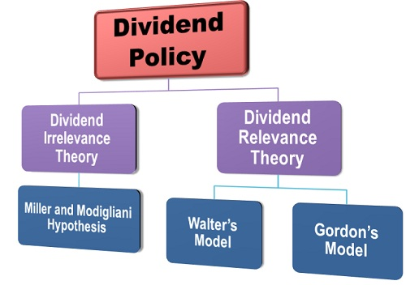
Types of Dividend Policy

Slide 13
Walter’s Model
Professor James E. Walter argues that the choice of dividends policies almost always affect the value of the firm. Walter’s Model one of the earlier theoretical works, shows the importance of the relationship between the firm’s rate of return, r and its cost of capital, k in determining the dividend policy that will maximize the wealth of shareholders.

Slide 14
Assumptions of Walter’s Model
Walter’s model is based on the following assumptions:
Internal financing
Constant return and cost of capital
100 per cent payout or retention
Constant EPS and DIV
Infinite time

Slide 15
MCQ
The dividend policy must be formulated considering two basic objectives, namely
delaying the tax liability of the stockholder and information content.
maximizing shareholder wealth and delaying the tax liability of the stockholder.
maximizing shareholder wealth and providing for sufficient financing.
maintaining liquidity and minimizing the weighted average cost of capital.

Slide 16
Answer
C. maximizing shareholder wealth and providing for sufficient financing.

Slide 17
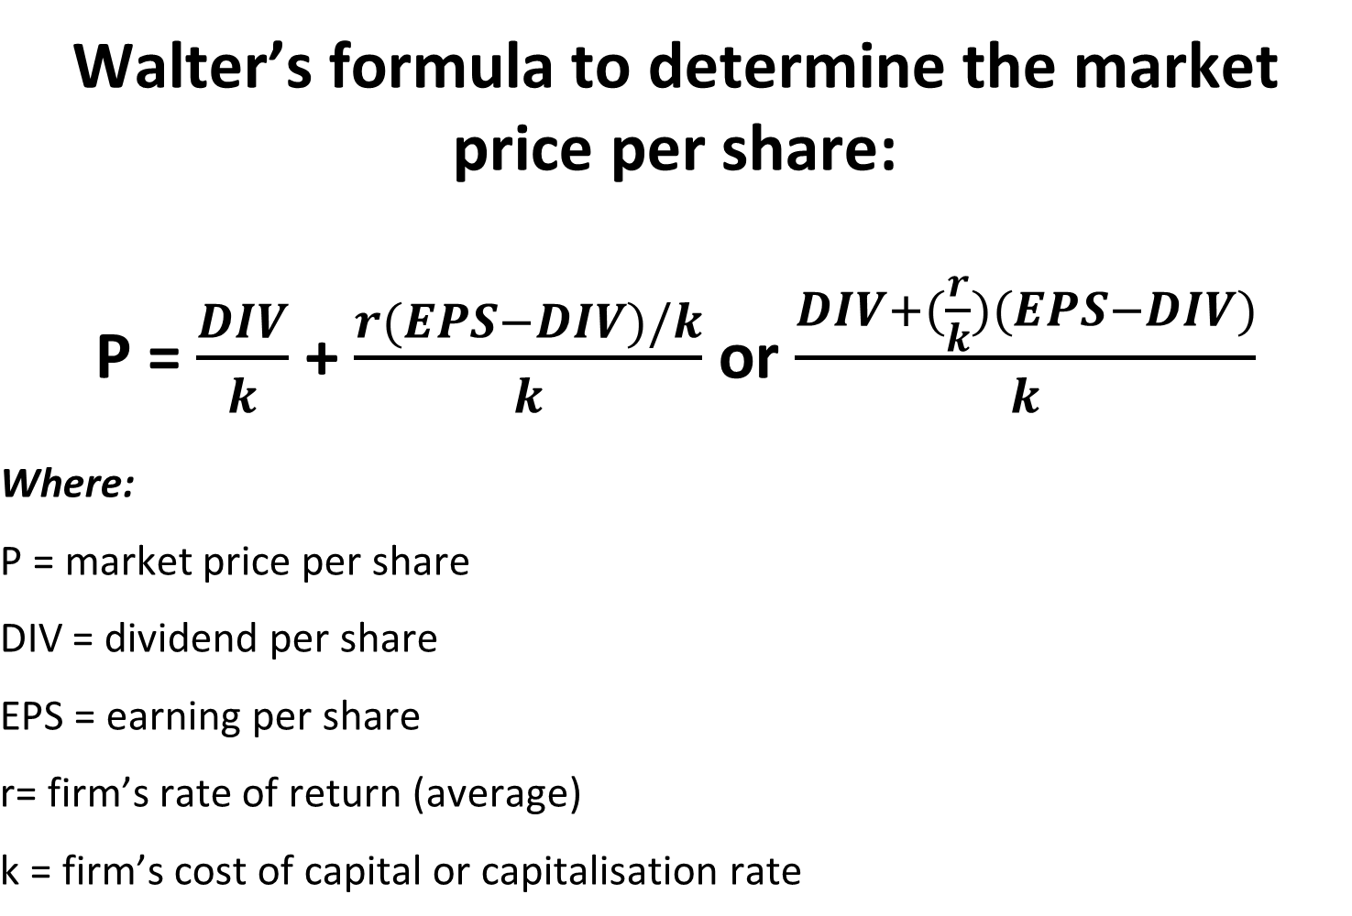

Slide 18
Optimum Payout Ratio
Growth Firms – Internal Rate More than Opportunity Cost of Capital (r > k). These firms are able to reinvest earnings at a rate (r) which is higher than the rate expected by shareholders (k). They will maximize the value per share if they follow a policy of retaining all earnings for internal investment.
Normal Firms – Internal Rate More than Opportunity Cost of Capital (r = k). Most of the firms do not have unlimited surplus generating investment opportunities. After exhausting super profitable opportunities, normal firms earn on their investments rate of return

Slide 19
Contd…..
equal to the cost of capital, r = k. For normal firms with r = k, the dividend policy has no effect on the market value per share in Walter’s model.
Declining Firms – Internal Rate Less than Opportunity Cost of Capital (r < k). These firms do not have any profitable investment opportunities to invest the earnings. These firms would earn on their investments rates of return less than the minimum rate required (r < k) by investors.

Slide 20
MCQ
The problem with a constant-payout-ratio dividend policy from the shareholder’s perspective is that
it bores the shareholders.
if the firm’s earnings drop, so does the dividend payment.
even when earnings are low, the company must pay a fixed dividend.
there is no informational content.

Slide 21
Answer
B. if the firm’s earnings drop, so does the dividend payment.

Slide 22
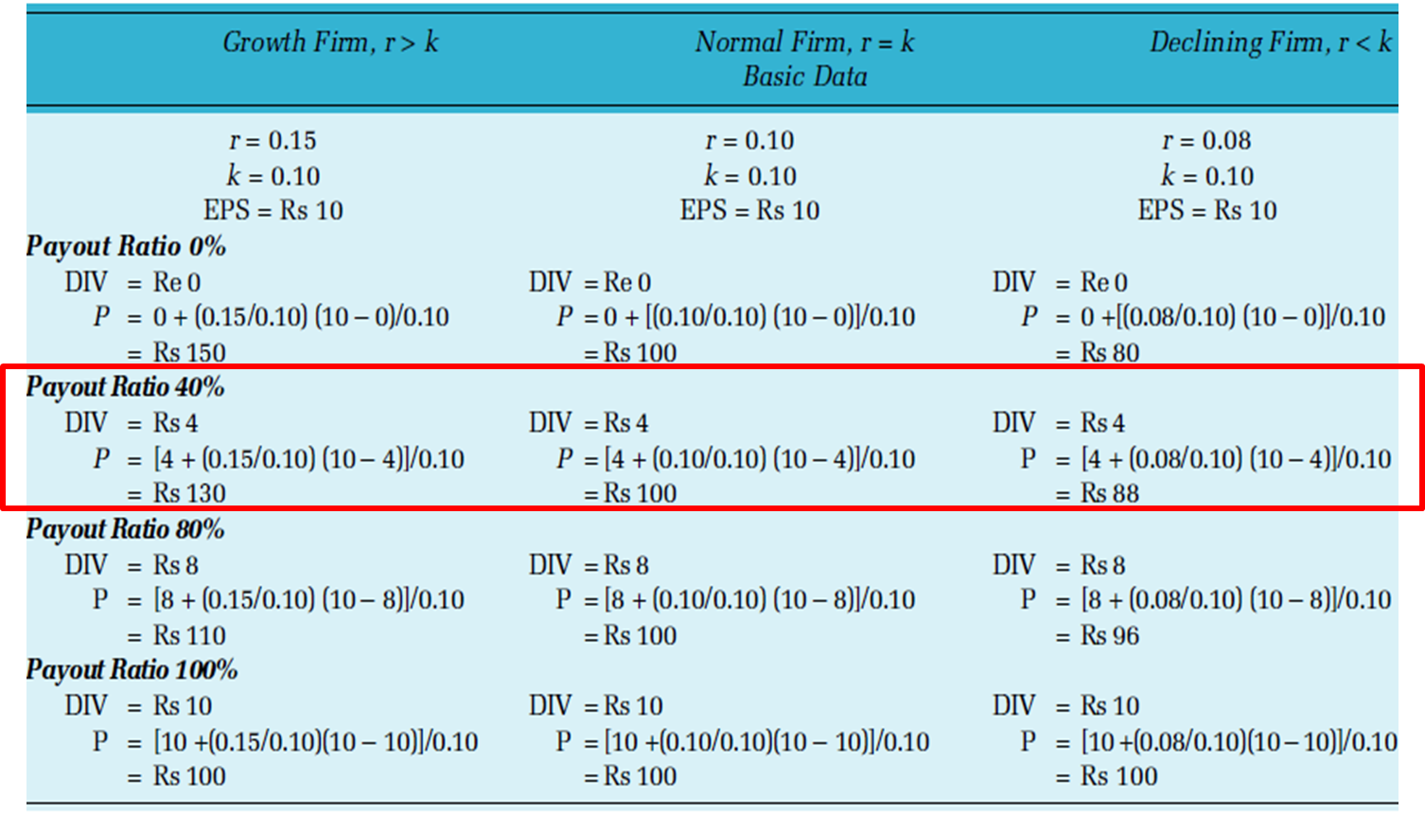
Illustration

Slide 23
Contd….
Thus, in Walter’s model, the dividend policy of the firm depends on the availability of investment opportunities and the relationship between the firm’s internal rate of return, r and its cost of capital, k. Thus:
Retain all earnings when r > k
Distribute all earnings when r < k
Dividend (or retention) policy has no effect when r = k.
Thus, dividend policy in Walter’s model is a financing decision. When dividend policy is treated as a financing decision, the payment of cash dividends is a passive residual.

Slide 24
Criticism of Walter’s Model
No external financing
Constant return, r
Constant opportunity cost of capital, k

Slide 25
MCQ
The problem with the regular dividend policy from the firm’s perspective is that
it bores the shareholders.
if the firm’s earnings drop, so does the dividend payment.
even when earnings are low, the company must pay a fixed dividend.
it increases the shareholders’ uncertainty.

Slide 26
Answer
C. even when earnings are low, the company must pay a fixed dividend.

